Slide 1
Preprocess

Slide 2
The purpose of preprocess
Our search engine has two methods ranking the webpage
TFIDF and PageRank
TFIDF : Count the term frequency in list of keywords
PageRank : Algorithm by counting the number of hyperlinks

Slide 3
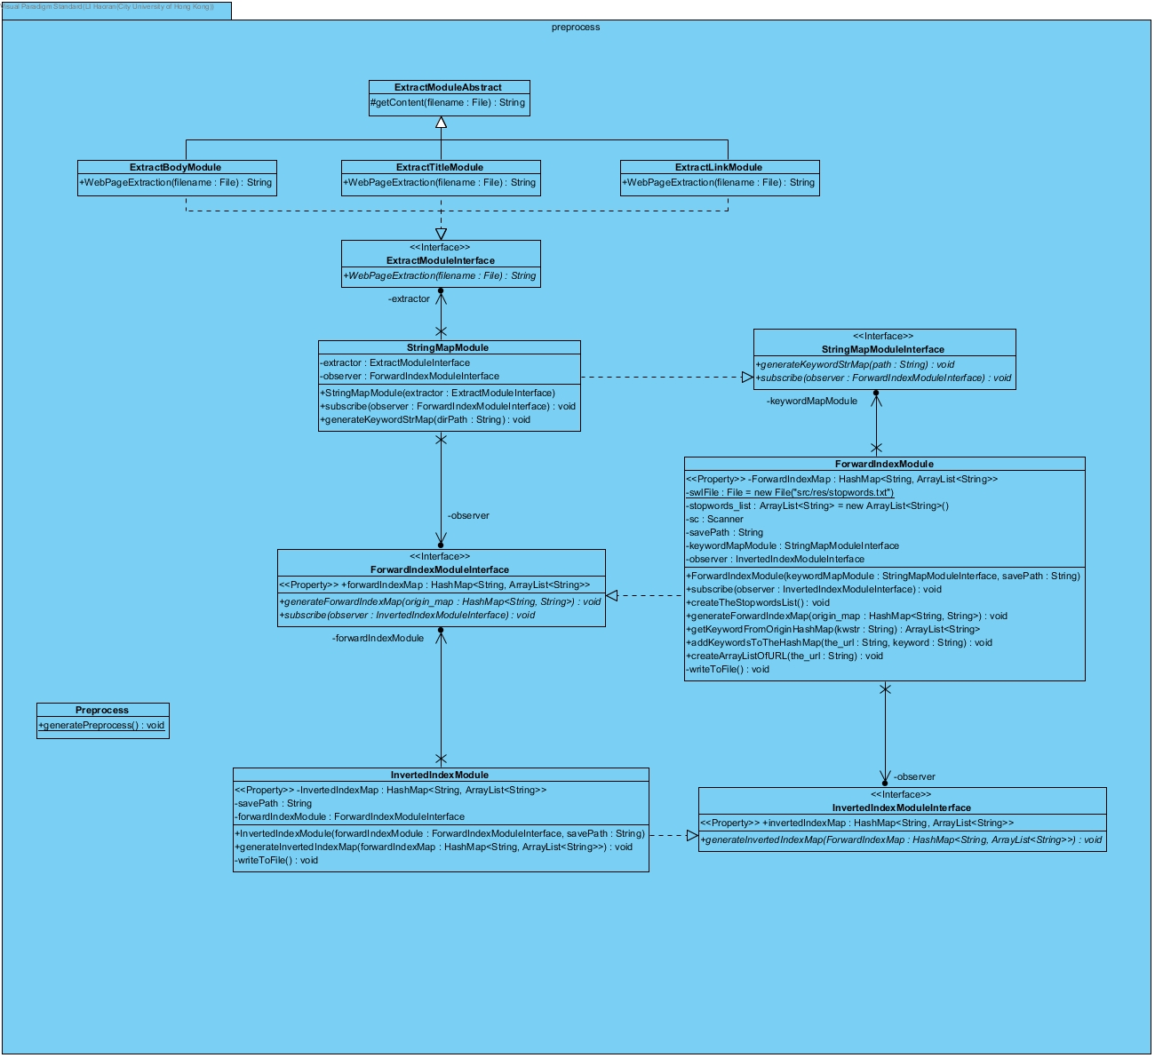

Slide 4
Flow of the preprocess
Html file
Content of webpage
Hashmap<url, arraylist of keywords>
Hashmap<keyword, arraylist of urls>

Slide 5
StringMapModule
Generate the dataset file
ForwardIndexDataset
InvertedIndexDataset
linkForwardIndexDataset
linkInvertedIndexDataset
titleForwardIndexDataset

Slide 6
ExtractBodyModule
Method: WebPageExtraction
Input: html file of the webpage
Return Type: String
Return: content of the webpage without the html tag, header…
Use for the TFIDF algorithm

Slide 7
ExtractLinkModule
Method: WebPageExtraction
Input: html file of the webpage
Return Type: String
Return: the hyperlink of the webpage
Use for the PageRank algorithm

Slide 8
ForwardIndexModule
Create a hash map with URL and keywords
Remove stop words from the content of the webpage
Input: content of webpage
Output Type: HashMap<String, ArrayList<String>>
Output: URL, Array list of keywords

Slide 9
InvertedIndexModule
Invert the ForwardIndexModule
Input: HashMap<URL, Array list of keywords>
Output Type: HashMap<String, ArrayList<String>>
Output: Keyword, Array list of URL

Slide 10
Software design pattern
StringMapModule
HashMap<String, String>
Key: URL
Value: Content of webpage
InvertedIndexModule
HashMap<String, ArrayList<String>>
Key: Keyword
Value: URL
ForwardIndexModule
HashMap<String, ArrayList<String>>
Key: URL
Value: Keywords
Observer pattern
Observer pattern is used in those 3 classes.
Observer pattern can update the final hash map automatically

